Slide 1
Intro to Design Patterns
Lecture 4.1 – Observer Pattern

Slide 2
Reading
DPE
Chapter 18 – The Observer Pattern

Slide 3
If the Listeners are varying use the Observer pattern
Technique
All ‘listener’ classes inherit from the Observer base class.
The Subject class
Maintains a list of Observers*.
Provides attach and detach methods so the Observers can sign in/out dynamically.
Provides getState (and possibly setState) method(s).
Spins through the list when its state changes calling each Observer’s update method.
Benefits
Decouples the listeners from the subject class.
Follows the open/closed principle
Adding listeners doesn’t require changes to the subject class.

Slide 4
Consider a Store
Initially
Want to send welcome letter to new customers
Want to send credit card to their good customers
Want to send nastygram to those who are behind
Want to cancel those who default on the bills
Later
May want to verify address
Send coupons to those close to their brick & morter outlets
Enter in sweepstakes
Encourage credit counseling
Suit for unpaid debts

Slide 5
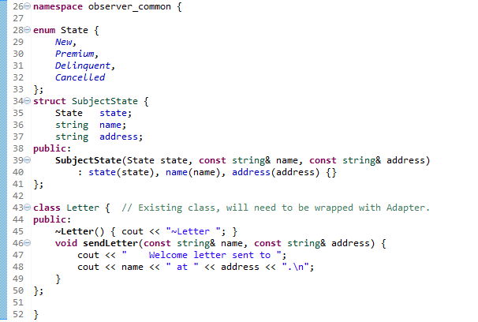
Common Code
Notes:
Subclassing by window features leads to combinatorial explosion.
Subclassing occurs at compile time.

Slide 6
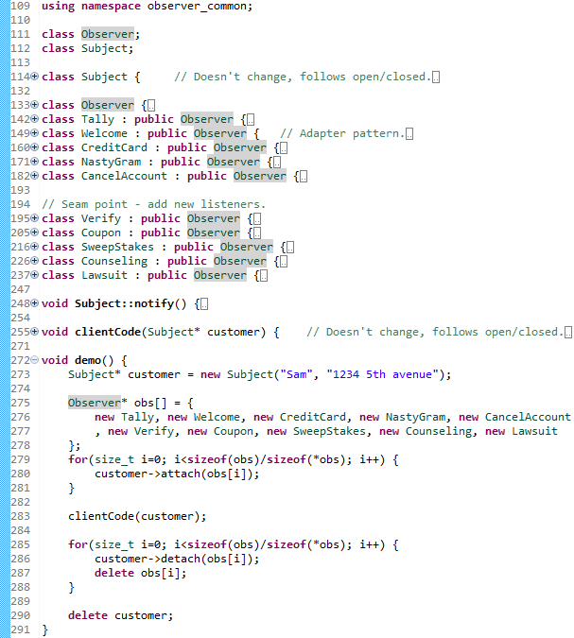
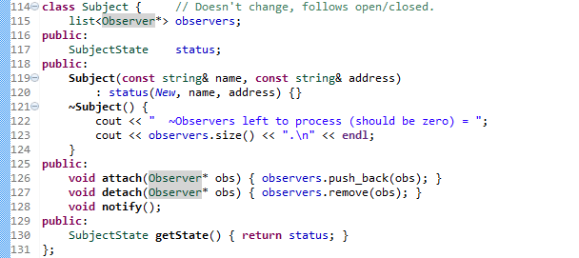
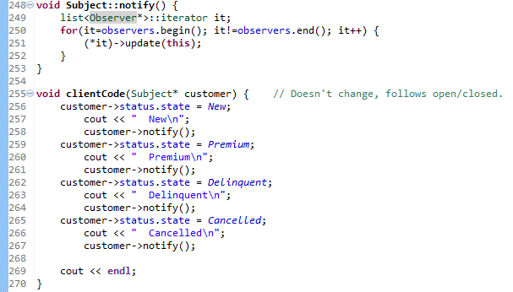
Solution Example
Notes:
Subclassing by window features leads to combinatorial explosion.
Subclassing occurs at compile time.

Slide 7
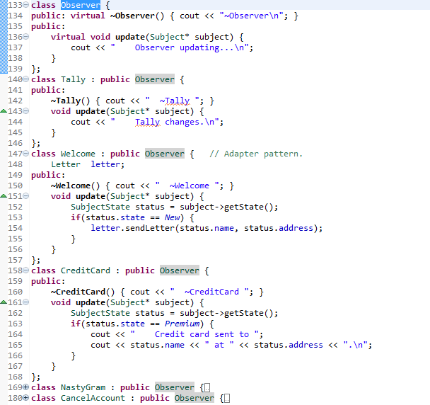
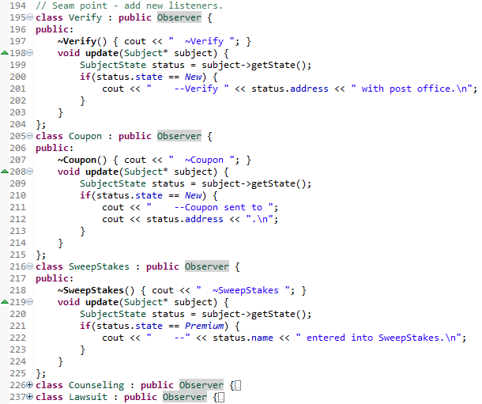
Solution Example
Notes:
Note the structure of the destructor sequences.
Note use of objects off the stack – can also allocate off the heap, but requires different cleanup code.

Slide 8
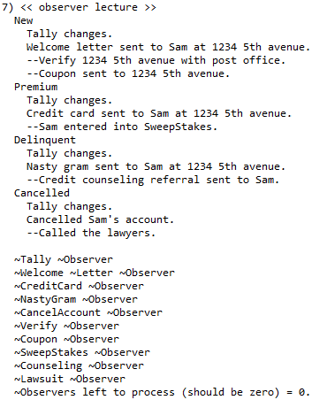
Output
Notes:
Note how the dtor unwinds the objects.

Slide 9
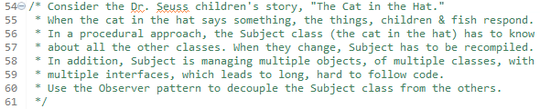
Homework

Slide 10
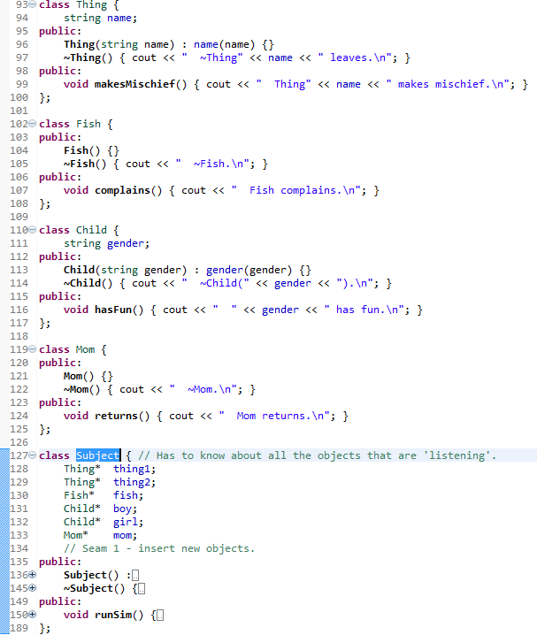
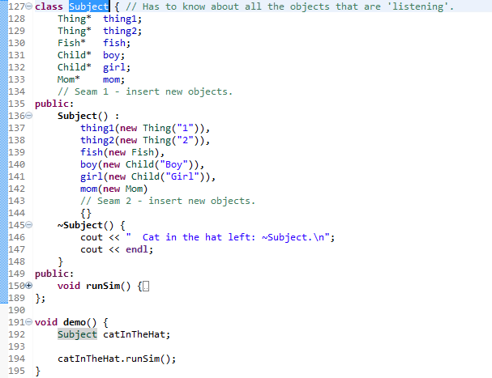
Problem

Slide 11
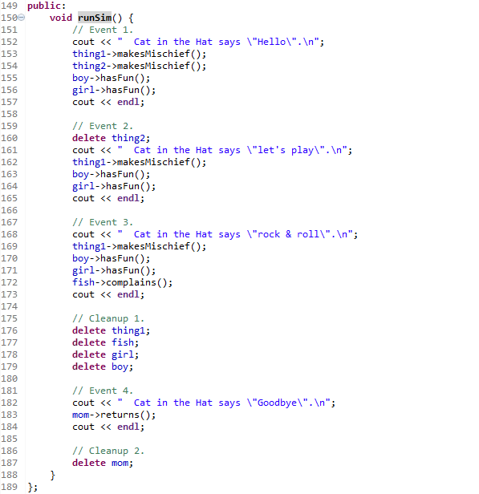
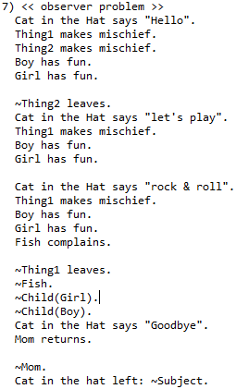
Problem Cont.

Slide 12
Summary
When the listeners are varying, use the Observer pattern to encapsulate the variation.
Observer decouples the Subject class from its listeners.
Observers register with the Subject dynamically.
Upon state changes, the Subject notifies all the registered Observers through their polymorphic update method.
Subject must provide sign in/out methods and typically get and set state methods.

Slide 13
Class Progress
If the algorithms are varying
If the interfaces are varying
If the API’s are varying
If the steps are varying
If the classes are varying
If the options are varying
If the listeners are varying
If the responders are varying
If abstract’n & implement’n vary
If the families are varying
Use the Strategy pattern
Use the Adapter pattern
Use the Facade pattern
Use the Template Method pattern
Use the Factory Method pattern
Use the Decorator pattern
Use the Observer pattern
Use Chain of Responsibility pattern
Use the Bridge pattern
Use the Abstract Factory pattern

Slide 14
Backup Slides

Slide 15
